Slide 2
Objectives
Describe how sensors, microprocessors and actuators can be used in collaboration to create automated systems
Describe the advantages and disadvantages of an automated system for a given scenario including:
Industry
Transport
Agriculture
Weather
Gaming
Lighting
Science

Slide 3
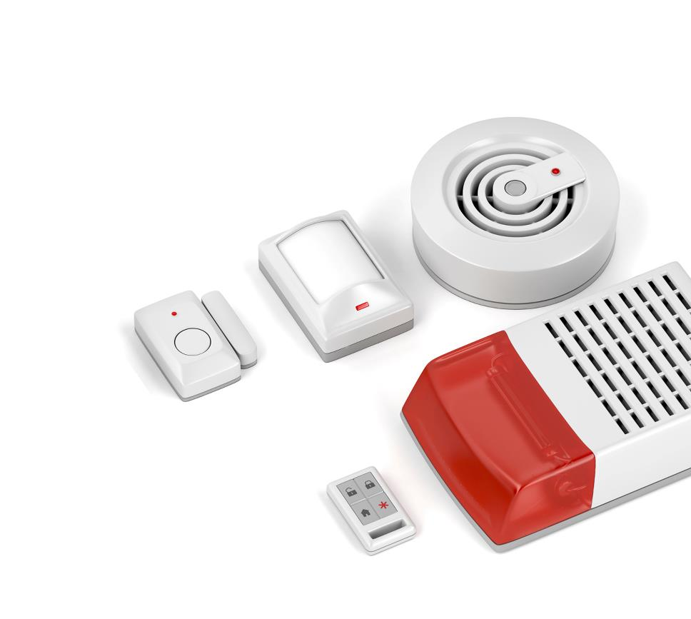

Starter
An automated alarm has a number of sensors
Name each of the sensors shown
How do they work to make an automated system?

Slide 4
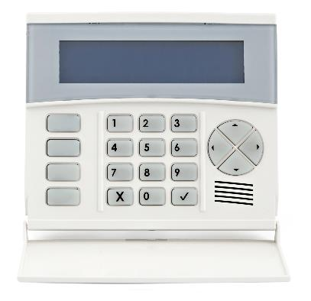
Starter
Magnetic door sensor – detects if a magnet moves away from its sensor – used on doors and windows
Smoke sensor used in a smoke detector
Infra-red / motion detector – detects warm moving objects
To make an automated system, the sensors need to be connected to a processor (which is usually inside a central unit with a key pad)

Slide 5
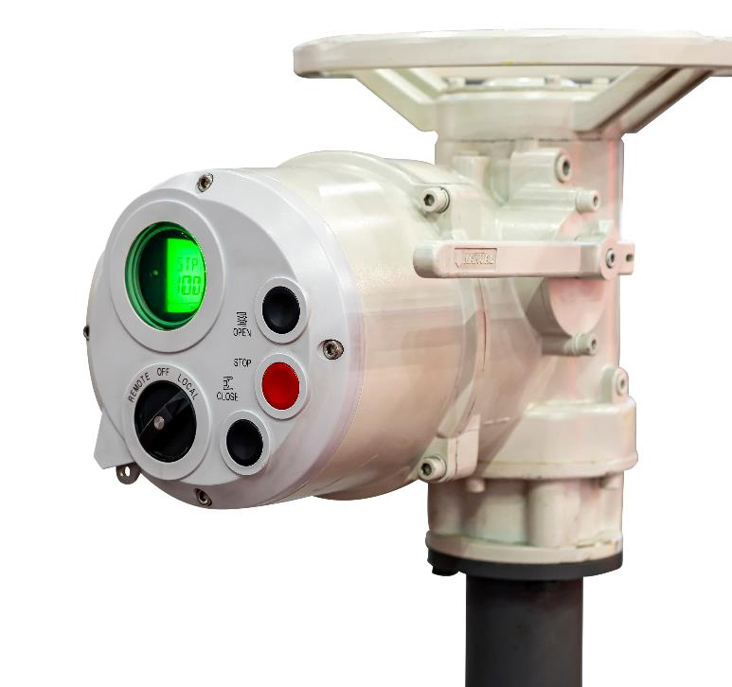
Automated systems
An automated system will need sensors to detect inputs, a microprocessor and output devices such as sirens, lights or actuators
Actuators are devices that control the operation of machinery
For instance, they may move a door or shut a valve on a pipe

Slide 6
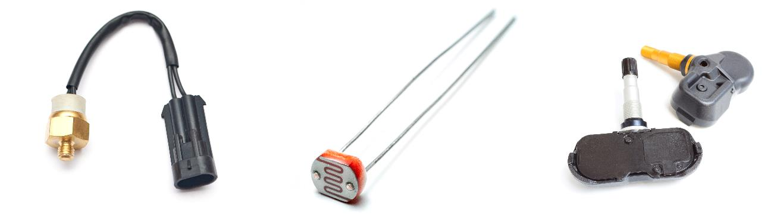
Sensors
Sensors detect properties from the physical environment
Name or guess the function of the following sensors

Slide 7
Sensors
Sensors detect properties from the physical environment
Name or guess the function of the following sensors
Car temperature sensor
Light sensor
(Light dependent resistor / LDR)
Car tyre pressure sensor

Slide 8
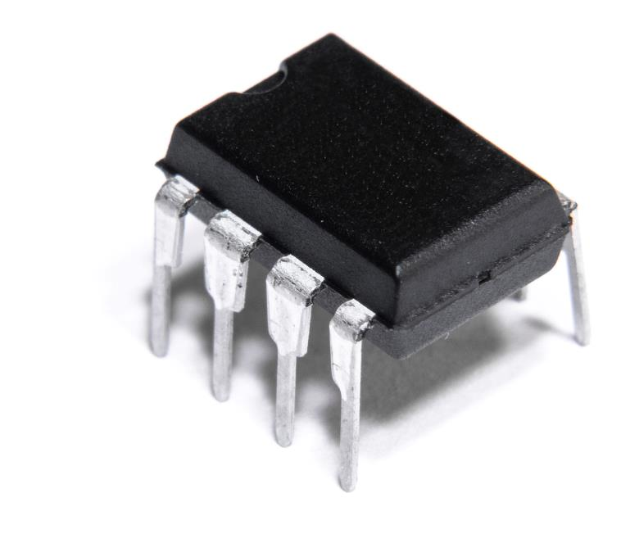
Microprocessors
Microprocessors are used to control automated systems
Data from sensors is used as inputs for the microprocessor
The data is processed so that actuators are correctly controlled
Microcontrollers are often used in automation
These contain RAM, ROM and a processor all on one unit

Slide 9
Worksheet 1
Complete Task 1 and Task 2 on Worksheet 1

Slide 10
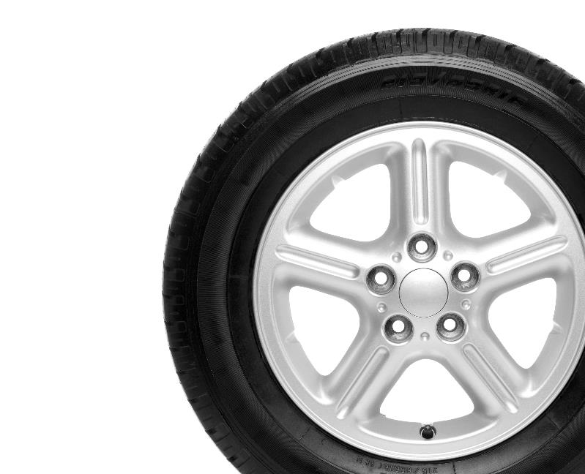
Transport
All cars made after 2014 must have a tyre pressure monitoring system (TPMS)
This safety system detects if the tyre has a flat tyre or a slow puncture
It warns the driver so they can stop and get the tyre fixed
How else are sensors and automation used in transport?
Consider cars, trains and aircraft along with the road network, train network and air traffic control

Slide 11
Transport
Some example answers:
Roads
Car cruise control system, motorway signs, traffic lights, pedestrian crossings, car parking space monitoring
Railways
Signals, signage, automatic breaking systems, automated train systems, toxic gas sensors in tunnels
Aircraft
Autopilot, air traffic control, systems for check-in, dropping off and collecting baggage

Slide 12
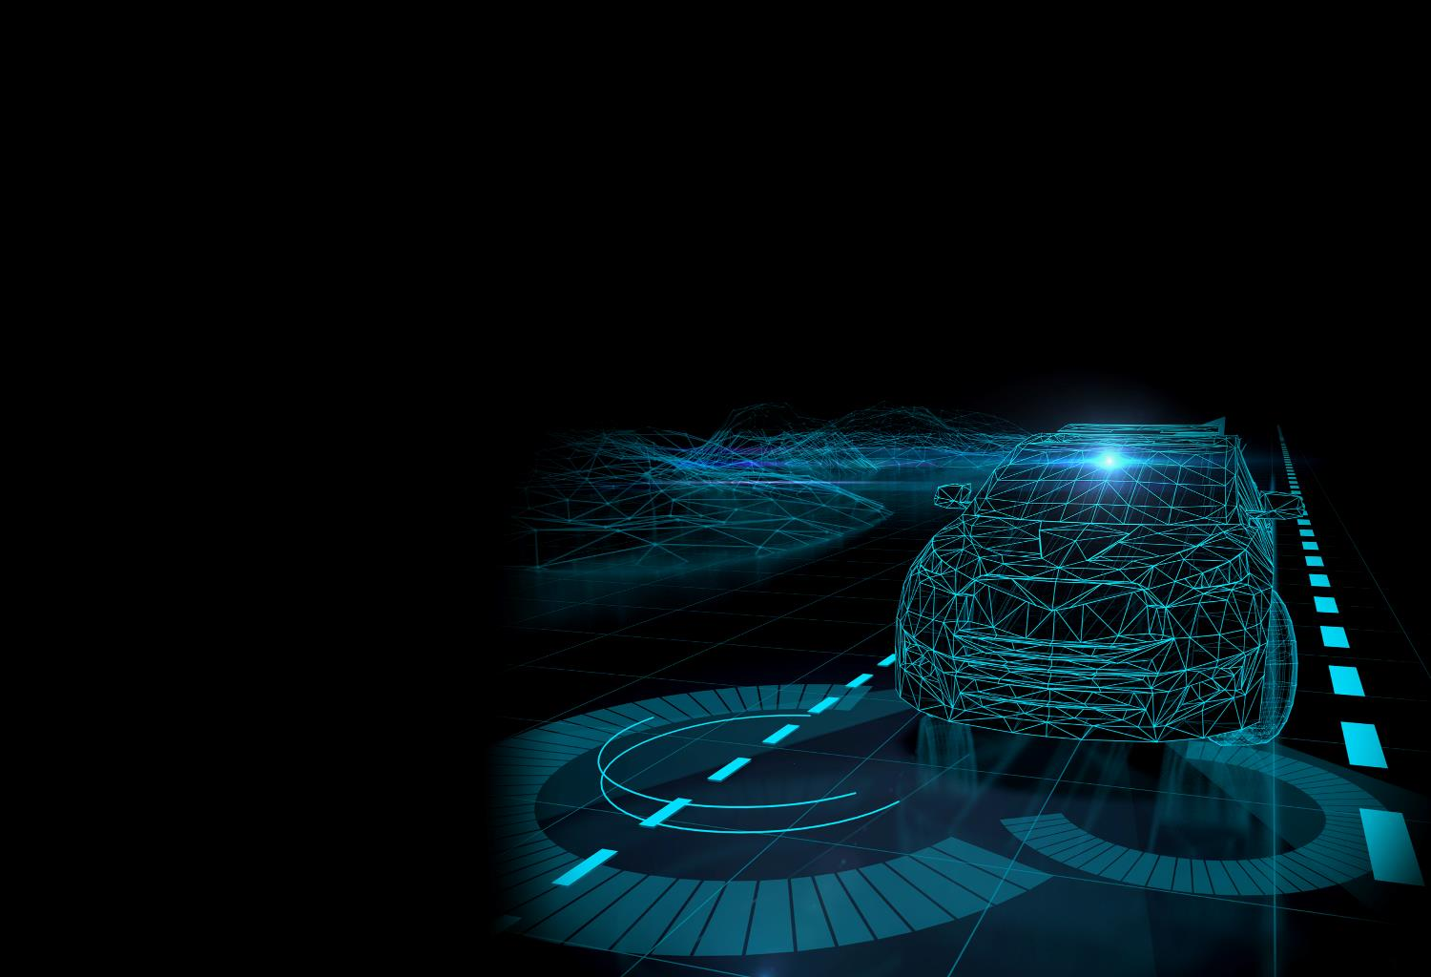

Self driving vehicles
Fully self driving vehicles are currently used in a small number of places in the world
Many cars are already fitted with abilities such as adaptive cruise control and automatic parking
What sensors do cars need for automation or self driving?

Slide 13
Automated car sensors
There are many sensors that may be used in cars
The following are likely to be used in self-driving cars:
Video cameras
Radar (Radio detection and ranging – to measure distance)
Ultrasonic (Uses high-pitched sound to measure distance)
LiDar (Light detection and ranging – to measure distance)

Slide 14
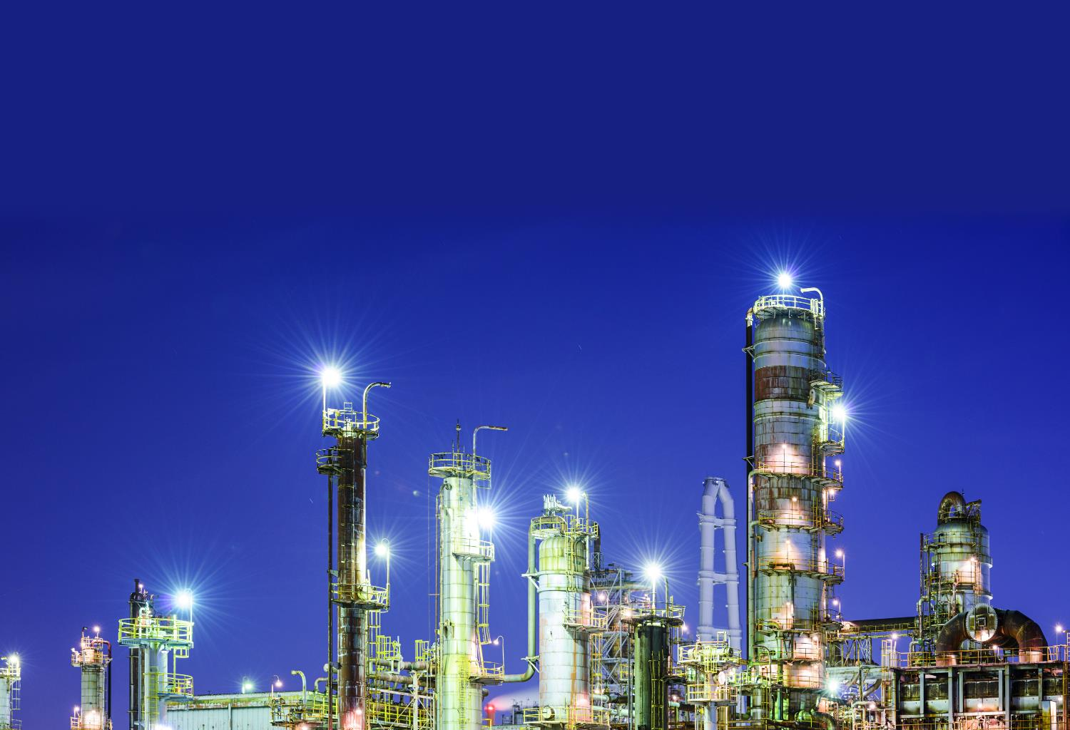
Industry
Industry uses automated systems to manufacture products or move products around warehouses
Name two examples of industry and explain how they might use automation

Slide 15
Industry
Some examples of automated systems in industry
Petrochemicals industry
This industry uses automation to pump fluids around chemical plants. They are used in the production of fertilisers, chemicals and oil refining into usable fuel
Food industry
The production of food, packaging and distribution are all automated
Automation requires fewer people and is able to work for longer hours

Slide 16
Worksheet 1
Complete Task 3 on Worksheet 1

Slide 17

Gaming
Automated systems are essential in gaming
The program logic, graphics and computer players are all automated
Various sensors can be located on input devices
Actuators are able to move seats or simulator cockpits
Give three advantages and three disadvantages of automated systems in transport, industry or gaming

Slide 18
Advantages/disadvantages
Advantages
Fewer people need to be employed
Repetitive tasks carried out with high accuracy and no breaks
Able to work in dangerous environments (industry)
More accurate simulation (gaming)
Disadvantages
People may lose their jobs or have fewer jobs to apply for
Automation can be very dangerous if something goes wrong
It is initially expensive to buy machinery

Slide 19
Worksheet 1
Complete Task 4 on Worksheet 1

Slide 20

Plenary
Give answers to the following questions
Name 5 industries that use automated systems
Name 4 types of sensor
Name 3 advantages of using automated systems
Name 2 disadvantages of using automated systems
Name 1 component responsible for processing instructions in an automated system

Slide 21
Plenary
Name 5 scenarios or industries that use automated systems Industry, transport, agriculture, gaming, lighting, science
Name 4 types of sensor Ultrasonic, light, button, oxygen, temperature, pressure,…
Name 3 advantages of using automated systems Fewer people required, work 24 hours a day, are able to work faster/more accurately than people in many tasks
Name 2 disadvantages of using automated systems High costs to purchase equipment, fewer jobs, mistakes made by machines may be harmful
Name 1 component responsible for processing instructions in an automated system Microprocessor

